Slide 1
Microsoft Power Platform
Notes:
Hi, Welcome to Microsoft Power Platform

Slide 2


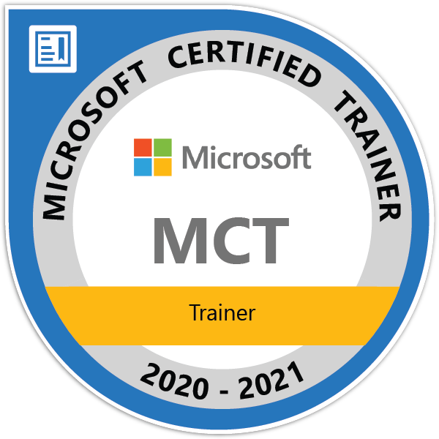

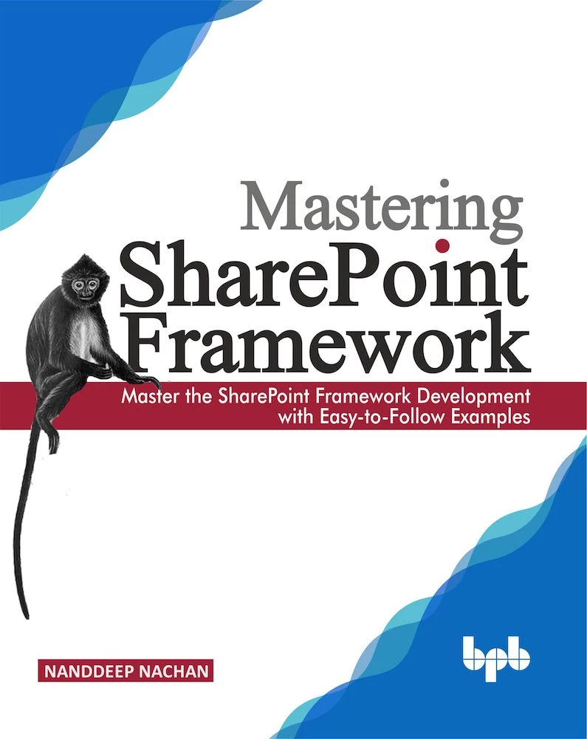

Nanddeep Nachan
Consultant - SharePoint, Office 365, MS Azure
Speaker | Author | Blogger
NanddeepNachan@gmail.com
/in/nanddeepnachan
@NanddeepNachan
https://www.nanddeepnachanblogs.com

Slide 3
Course Overview
Day 1 – Part I
Empowering Everyone with Power Platform – From CEO to Frontline Workers
Introduction to Power Platform
Day 1 – Part II
Power Packed Day with Power Canvas Apps
Introduction to Power Apps
Day 2 – Part I
Power Packed Day with Power Model Driven Apps
Let’s talk about data
Day 2 – Part II
Power Packed Day with Power Automate
Introduction
Day 3 – Part I
Power Packed Day with Power Agents
Introduction
Microsoft Power Platform momentum
Why Power Platform?
Customer Stories
Demo
Benefits of Power Apps
What can I build with Power Apps?
Types of Power Apps
Canvas Apps
Data Sources and Connectors
Demo
Types of Data
Dataverse
Model-driven Apps
What type of components can I add?
Data model design
Demo
Types of flow
Data types and expression
Working with Arrays
Control flow and action settings
Demo
A Robust Virtual Agent Platform
Converse everywhere
Easily make your bots better
Create personalized customer experiences
Transfer to a human agent
Built on Power Platform & Azure Bot Service
Extend your bot capabilities with Azure Bot Service
Demo

Slide 4
Continue…
Day 3 – Part II
Power Packed Day with Power BI
Introduction
Day 4 – Part I
Power up your Apps with AI Builder
Introduction
Day 4 – Part II
Power Platform Administration, Security & Integration Connectors
Introduction
Day 5 – Part I
Power Platform integration with SharePoint
Introduction
Day 5 – Part II
Power Platform integration with MS Teams
Introducing Dataverse for Teams
AI for every app. And everyone
Setup Environment
Types of AI Model
Prediction
Form processing
Object detection
Text classification
Demo
The 5x5 Principle
Customer momentum: Power BI
Power BI Desktop
Data sources
Power Query
Dataflow
Paginated Reporting
Power BI Admin Portal
Demo
Secure your tenant
Monitor your tenant’s activity
Alert & act on that activity
Connectors
SharePoint Integration
Demo
Make Power Apps a MS Teams App
Integrate Power Automate with MS Teams
Integrate Power Virtual Agents with MS Teams
Use case: Leave Management Application
Demo
Modify SharePoint list forms with Power Apps
Build Approvals in SharePoint with Power Automate
Use case: Manage Project Lifecycle
Demo

Slide 5
Day 1: Empowering Everyone with Power Platform
From CEO to Frontline Workers – Part I

Slide 6

Agenda
Introduction to Power Platform
Microsoft Power Platform momentum
Why Power Platform?
Customer Stories
Demo

Slide 7
Notes:
Microsoft is building the world’s most comprehensive connected business cloud.
Microsoft uniquely positioned to do that by leveraging the power of unified data and applied intelligence.
Why? Why is this important?
It’s because of our customers.
It’s important because our customers need four things to accelerate their business success

Slide 8












Innovate across industry
Industries are being disrupted. Transform to disrupt yours.
Consumer goods
Education
Non-profit
Healthcare
Professional services
Central government
Education
Non-profit
Healthcare
Financial services
Travel
Technology
Insurance
Utilities
Transportation
Technology
Utilities
Transportation
Public sector
Retail
Banking
Energy
Local government
Manufacturing
Public sector
Retail
Banking
Manufacturing

Slide 9








Optimize across organizations
From startups to multinational corporations
Education
Non-profit
Healthcare
Utilities
Transportation
Public sector
Retail
Banking
Technology
Manufacturing

Slide 10

Reactive action
Proactive action
Siloed view
Connected view
Incomplete data
Holistic data
Reporting activity
Delivering outcomes
Notes:
Instead of reacting to what happened, customers need to take proactive action based on insights
Instead of looking at their business in parts, they need to access a holistic view of their entire business, from marketing to sales to back-office operations and more
Instead of making decisions based on incomplete information, they need to draw on every connected data source to help predict the next best action
Instead of focusing on reporting activity that happened in the past, they need to pursue meaningful business goals and outcomes for the future
These are the attributes a customer needs to be successful
How?

Slide 11

Notes:
It starts with how they get the most out of their business data
Data is everywhere – generated at every step of our lives
90% of world’s data generated in last 3 years alone
Everything we do, everything our customers do, everything competitors do generates some kind of data
T: In the old world, that data lived in siloes

Slide 12

Notes:
The applications that ingest that data, trap that data
When data is trapped, organizations can’t move to a proactive position, they can’t see a holistic view of their business, they can’t make decisions based on all available information
T: How do we free organizations from the data silos that plague them?

Slide 13
Transform
products
Optimize
operations
Data & AI
Engage
customers
Empower
people
Notes:
That has been at the core of our strategy for Microsoft’s business applications
For organizations to be successful, they need to digitally connect every asset of their business – optimizing operations, empowering people, engaging customers, and transforming products
To help customers accelerate their businesses, we needed to create a set of solutions that unified their data and delivered applied, inherent intelligence right within the solution
T: That what we’ve done with Dynamics 365 and the Power Platform

Slide 14
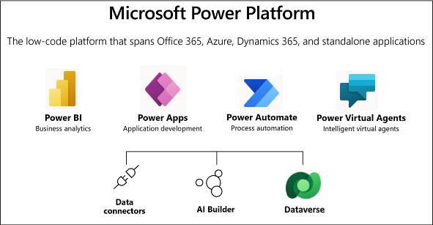
Microsoft Power Platform
The low-code platform that spans Office 365, Azure, Dynamics 365, and standalone applications
Innovation anywhere. Unlocks value everywhere.

Slide 15
Why Power Platform?
Time
Resources
Cost
Data
Maintenance

Slide 16
Low Code Evolution

Slide 17

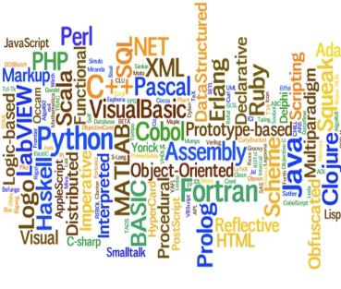


The evolution of how people buy applications
Custom Software
Packaged Software
Low-code Development
What development language do you use?
How feature rich is your software?
How agile and extensible is your platform?
ERP
CRM
HRM
ERP
CRM
HRM
Middle
-ware
MRP
Middle
-ware
PRM
MRP
PRM
MRP
OPS
LOG.
…
OPS
PRM
…

Slide 18
Benefits of low-code development platforms
Environment used to create web or mobile applications easily by mostly configurations, drop-and drops.
LOW-CODE
DEVELOPMENT PLATFORMS
Higher rate of success
Loved by both Business & IT
Breeds Innovations
Days to Weeks
Success Rate
Time to Live
Business Relevance
Innovative Culture
Traditional computer programming, writing lines of codes from scratch.
Failed projects are common
Lagging IT & constant tension with business
TRADITIONAL
DEVELOPMENT
Months to Years
Curbs Innovation

Slide 19
Continue… Part 2

